Slide 1



WhatsApp Clone
&
Vishnu Pratap Singh Chauhan
Shruti
Rohit Kumar

Slide 2
Index
Objective
Introduction to Flutter
Why Flutter
The App
Skills Used
References

Slide 3
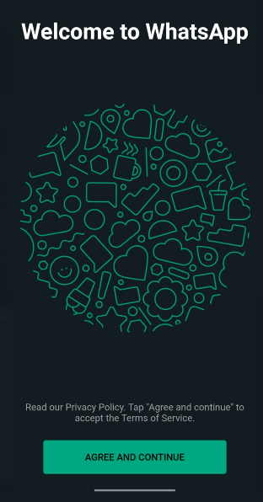
Objective
To create a real-time chatting app inspired by whatsapp which consists of the following features:
  Authentication via otp
  Make new users in firestore database
  Real-time chat feature
  Group-chat
  Group -videocall

Slide 4
Introduction
> Flutter is an open-source software development kit which enables smooth and easy cross platform mobile app development.
> You can build high quality natively compiled apps for iOS and Android quickly, without having to write the code separately for two apps. All you need is one codebase for both platforms.
>Firebase is a Backend-as-a-Service (BaaS) app development platform that provides hosted backend services such as a realtime database, cloud storage, authentication, crash reporting, machine learning, remote configuration, and hosting for your static files.

Slide 5
Why Flutter
Few key factors that make flutter an excellent choice for this task:
High Performance
Platform Independent
Availability of complex UI and customization library
Adapt to various screen sizes and reach wider user base

Slide 6
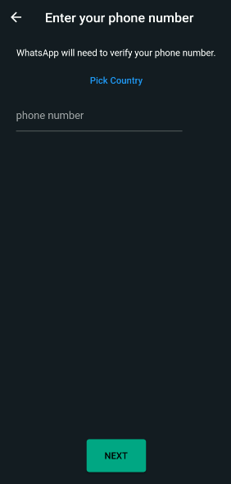
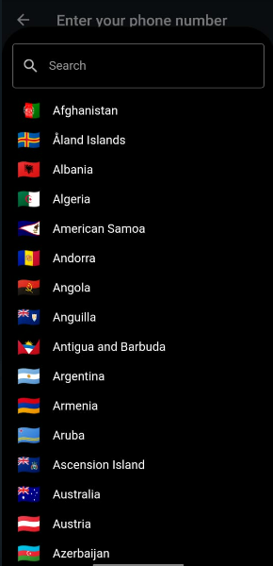
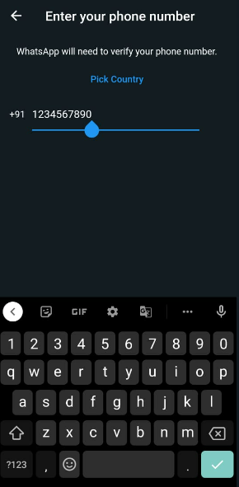
The App
The App starts with get started page on Whatsapp, which navigates you to the login screen.
Upon selecting country and number, the firebase generates an OTP for phone number verification.

Slide 7
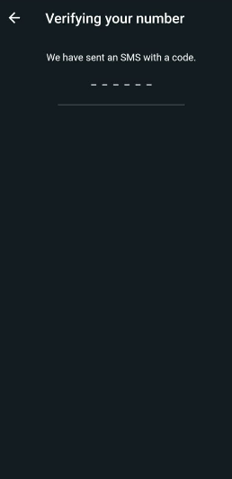
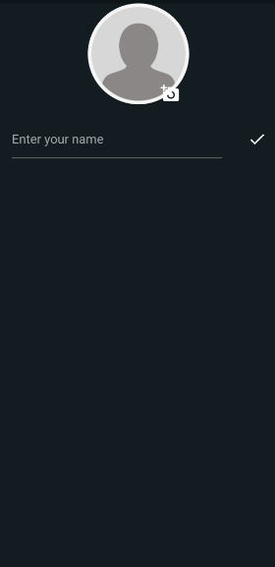
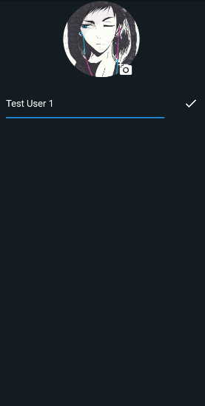
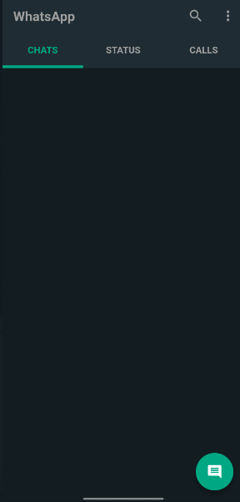
The App

Slide 8
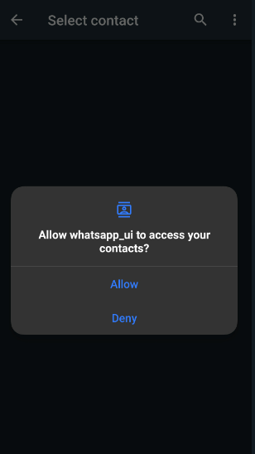
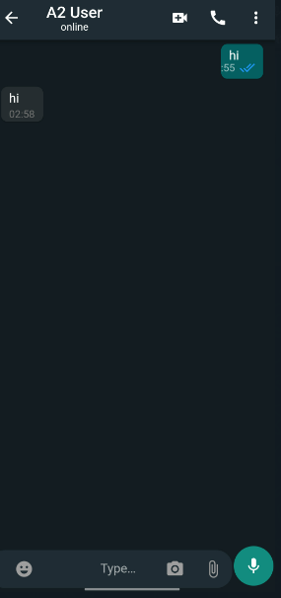
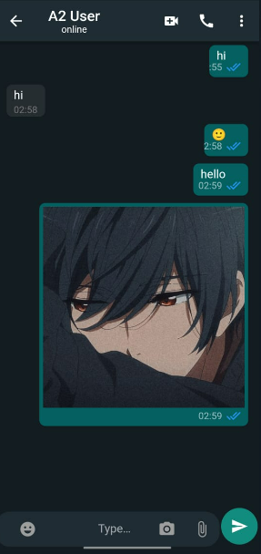
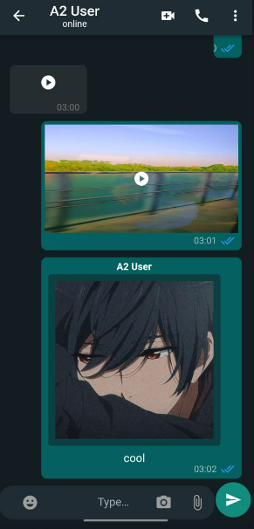
The App

Slide 9
Skills Used
Enabling Backend Using Firebase console
Enabled phone number verification via text otp generation
Saving user data such as profile picture etc.
Connected the project to firebase.
Object Oriented Approach
Handling various functionalities by binding them in Class and creating
objects of them.
Reusability of Code, Reducing Redundancy.

Slide 10
Skills Used
State Management
Stateless/Stateful widgets.
Flutter reflects its UI by reflecting current state.
State is read while widget is built and can be changed using setState()
for Stateful widgets.
Error Resolving
Successfully resolved various error tat occurred throughout the development of the software, ensuring smooth and fast working of the project as a whole.

Slide 11
Skills Used
Use of 3rd Party Packages
Use of external packages provide application with variety of useful functionalities.
Make Application Stand Out.
Dependencies Used
firebase_storage: ^10.3.1
country_picker: ^2.0.17
firebase_core_platform_interface: 4.5.1
flutter_riverpod: ^2.0.0-dev.9
image_picker: ^0.8.6
flutter_contacts: ^1.1.5+1

Slide 12
References
Official Documentation of Flutter
https://docs.flutter.dev/
Project Repositories:
https://github.com/shru-ty/wa_clone

Slide 13

Thank you for your time.
Mini Project
https://github.com/shru-ty/wa_clone
# Team
Vishnu Pratap Singh Chauhan (201500803)
Shruti (201500676)
Rohit Kumar(201500)

